Slide 1
Identifying Police Officers at Risk of Adverse Events
Date: 2016/10/13
Author: Samuel Carton, Ayesha Mahmud, Crystal Cody, Jennifer Helsby, Youngsoo Park, CPT Estella Patterson, Rayid Ghani, Kenneth Joseph, Joe Walsh, Lauren Haynes
Source: KDD '16
Advisor: Jia-Ling Koh
Speaker:Chen-Wei Hsu

Slide 2
Outline
Introduction
Method
Experiment
Conclusion

Slide 3
Introduction
Motivation
Adverse events between police and the public, such as deadly shootings or instances of racial profiling, can cause serious or deadly harm, damage police legitimacy, and result in costly litigation
Today’s EIS are not data-driven and typically rely on simple thresholds based entirely on expert intuition

Slide 4
Introduction
Goal
We apply, to our knowledge, the first use of machine learning toward prediction of adverse incidents from internal police department data
We show significant improvement over existing systems at flagging at-risk officers
We take preliminary steps toward understanding the situational factors that lead to an adverse event.

Slide 5
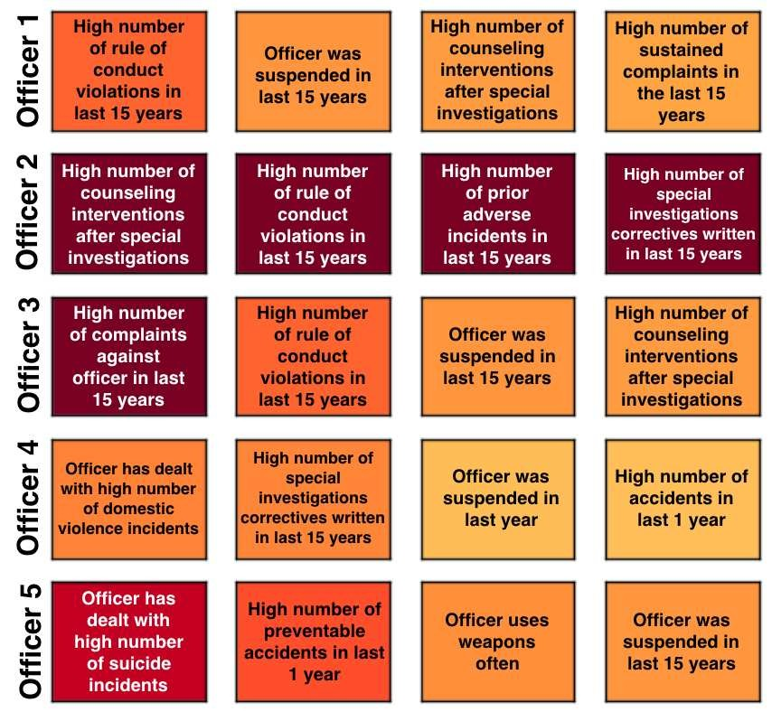
Introduction
Figure 1: An illustration of five at-risk officers that will go on to have an adverse incident and their risk factors. The darker the red, the stronger the importance of that feature

Slide 6
Introduction
To improve the current system, we focus on the following prediction task:
Given the set of all active officers at time t and all data from time periods prior to t, predict which officers will have an adverse interaction in the next year.

Slide 7
Introduction
Framework
EISs
Predict which officers will have an adverse interaction in the next year
Training Modle
New feature
Random Forests

Slide 8
Outline
Introduction
Method
Experiment
Conclusion

Slide 9
Method
EXISTING EARLY INTERVENTION SYSTEMS
EISs, which are designed to detect officers exhibiting alarming behavioral patterns and prompt intervention such as counseling or training before serious problems arise, have been regarded as risk-management tools for countering this issue
threshold systems are easily gamed
threshold-based systems are difficult to customize

Slide 10
Method
POLICE MISCONDUCT
officer characteristics
situational factors
neighborhood factors

Slide 11
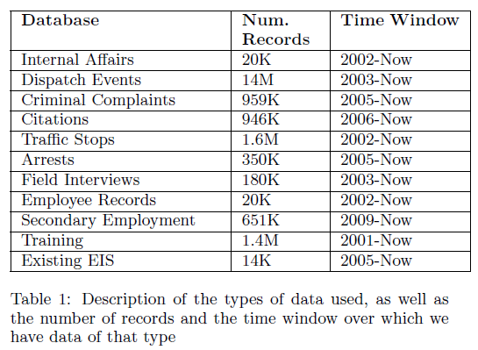
Method
DATA DESCRIPTION

Slide 12
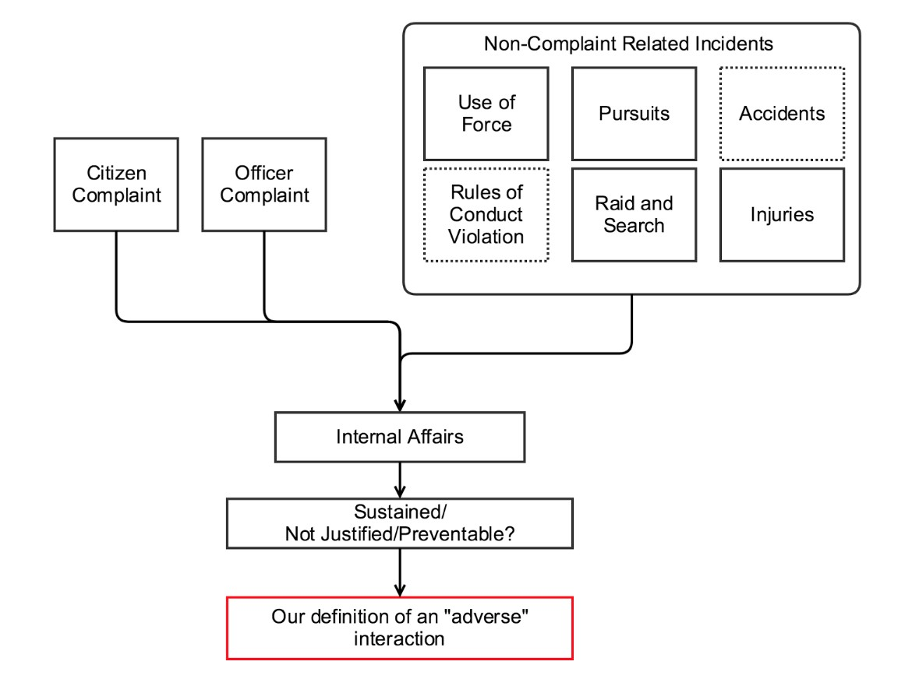
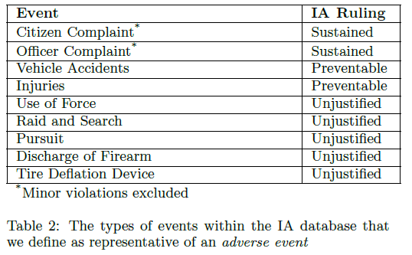
Method
Internal Affairs Data
justified
preventable
sustained

Slide 13
Method
Data Limitations
traffic stops, field interviews, and criminal complaints are entered into the CMPD system by the officers themselves, often in the midst of busy shifts or retroactively after their shifts have ended

Slide 14
Method
Feature Generation
432 features
officer level, we generate behavioral features by aggregating the record of incidents by each officer, establishing a behavioral history
a sudden increase in the number of arrests in the six-month period prior to the point of analysis
include the existing EIS thresholds as featured in our model

Slide 15
Method
Model Evaluation
AdaBoost
Random Forests
Logistic Regression
Support Vector Machines

Slide 16
Outline
Introduction
Method
Experiment
Conclusion

Slide 17
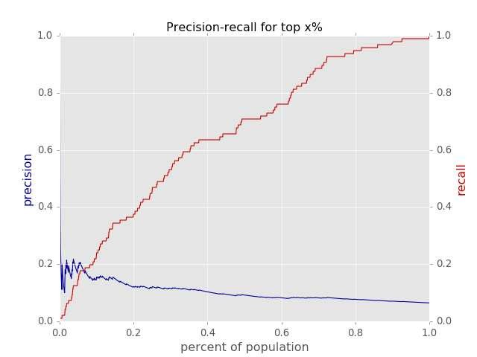
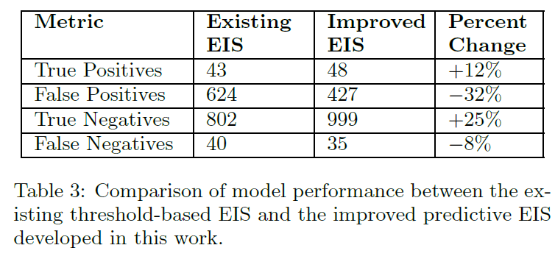
Experiments
Predictive Performance

Slide 18
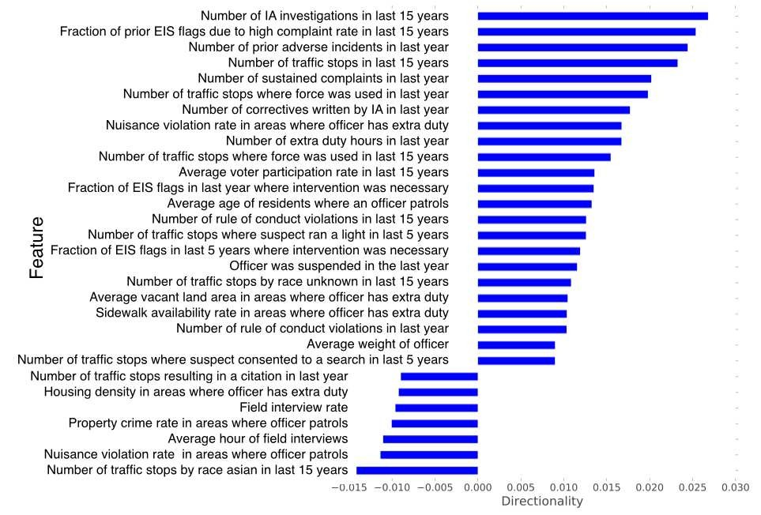
Experiments
Feature Analysis
Figure 4: Feature directionalities from the officer-level random forest model

Slide 19
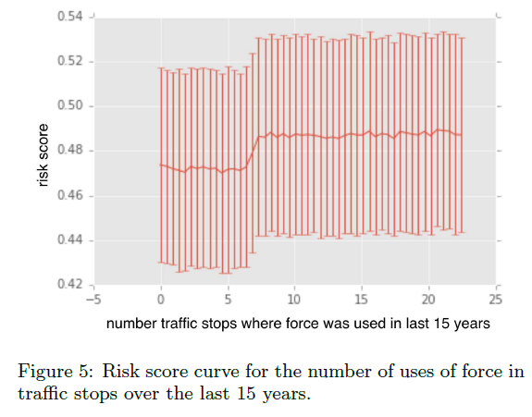
Experiments

Slide 20
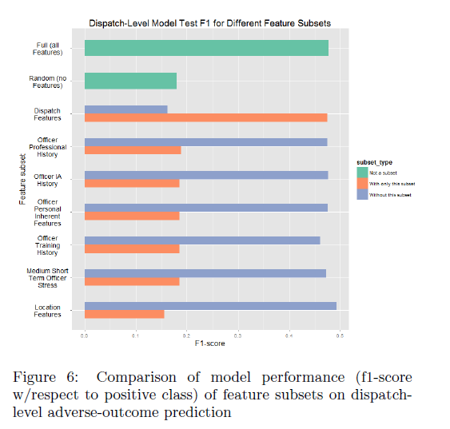
Experiments

Slide 21
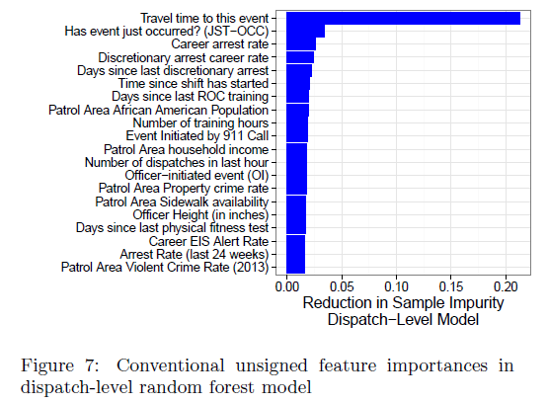
Experiments

Slide 22
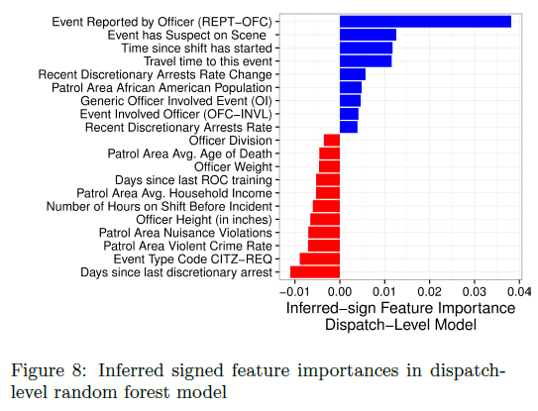
Experiments

Slide 23
Outline
Introduction
Method
Experiment
Conclusion

Slide 24
Conclusion
our goal is to take this system, developed for CMPD, and extend it to other departments across the US
We are hopeful that work at the intersection of data science, social science and the practice of policing can someday help to advance the work being done in these contexts as well

